Slide 1

You Are What You Eat: Obesity Classification Based on Weekly Habits
Project-2 @ METIS
Jhonsen Djajamuliadi

Slide 2
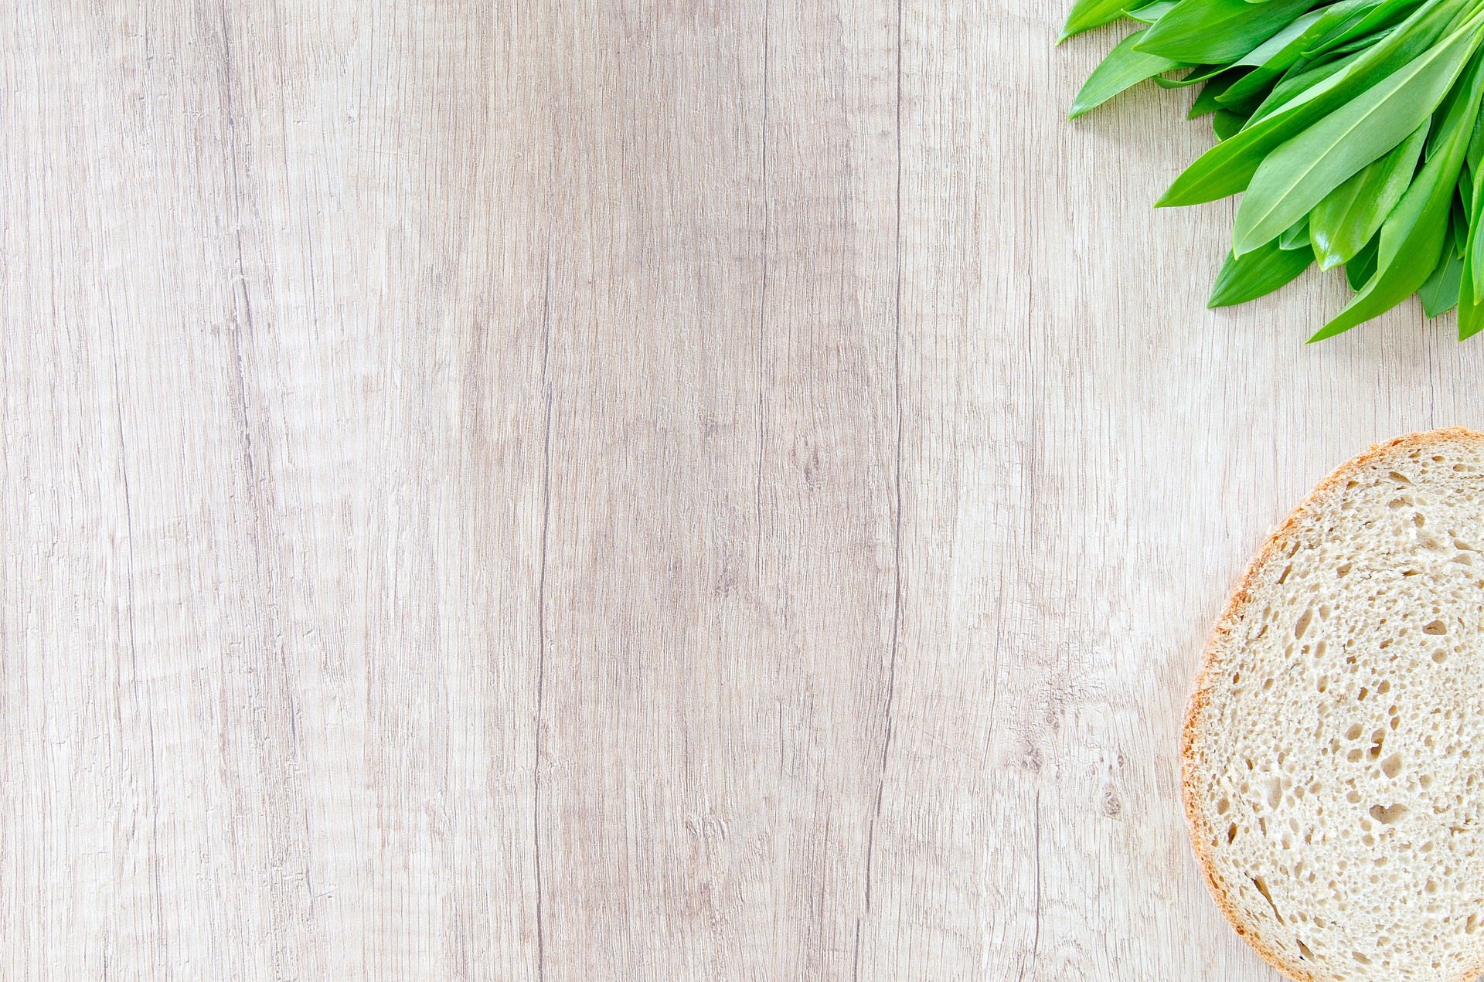
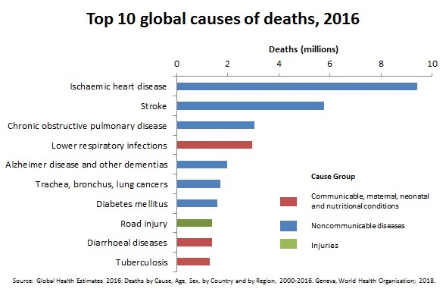

Obesity-Related Diseases
Top 10 Causes of Death Worldwide
Deaths (million)
0
2
4
6
8
10
Heart Disease
Heart Disease
Stroke
Stroke
Pulmonary Disease
Respiratory Infection
Deaths by obesity-related diseases^{[1]}
Alzheimer & dementias
Cancers
Cancers
Diabetes
Diabetes
Road Injury
Diarrhoeal Diseases
Tuberculosis
Global Health Estimates 2016, from WHO, 2018
[1] Obesity related diseases https://www.cdc.gov/obesity/adult/causes.html

Slide 3
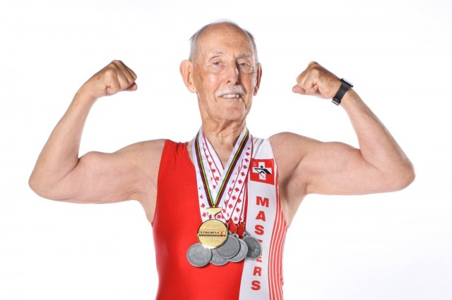
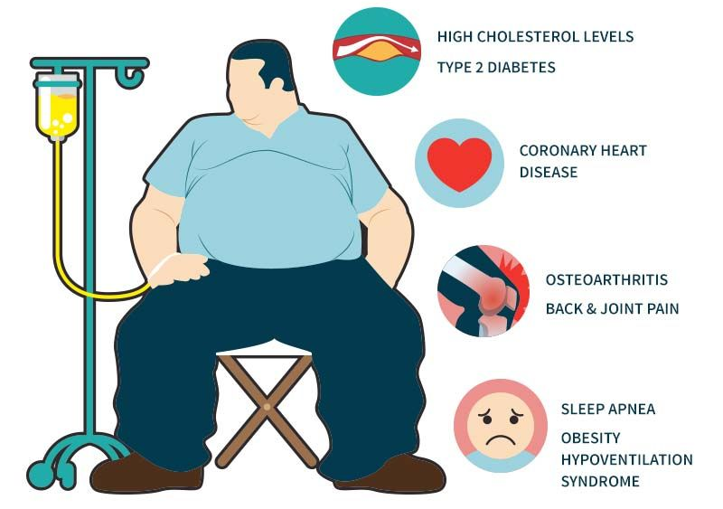
Project Motivation & Theme
Charles Eugster, 97
Small changes
∝ Big impact
today
future
https://www.agebrilliantly.org/charles-eugster-champion-elderly-world-record/
Obese | Not Obese
Disease Healthy
Question:
What small changes can I make, today?
https://www.pinterest.com/pin/367606388318247552/

Slide 4



Data-Driven Investigation
American Time Use Survey (ATUS)
Eating & Health Module Microdata
Files
6 years
(2006-2008, 2014-2016)
Feature Selection
37 Questions and Answers
BMI
“User-Friendly” Features
Actionable, on a weekly basis
Doable immediately
No privacy concerns
Time_Eat
Time_Snack
Exercise_Freq
Fastfood_Freq
General_Health
Obese
30
Not
Obese
Features of Importance
Target

Slide 5
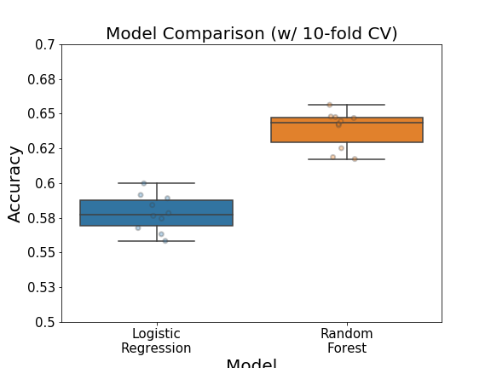
Data-Driven Investigation
American Time Use Survey (ATUS)
Eating & Health Module Microdata
Files
Interpretability
vs. Predictive Power
Feature Selection
Model Selection
Misclassifying a diseased-patient is costly
Notes:
IF a PERSON has DISEASE, but we MISS IT.

Slide 6
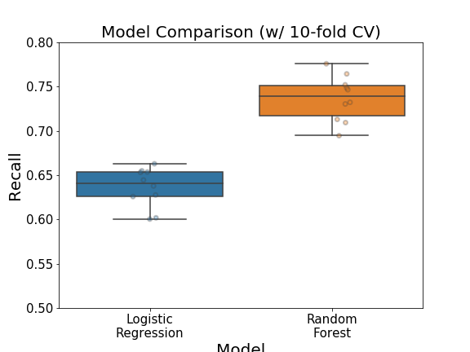
Data-Driven Investigation
American Time Use Survey (ATUS)
Eating & Health Module Microdata
Files
Interpretability vs. Predictive Power
Feature Selection
Model Selection

Slide 7
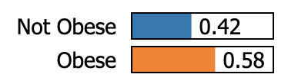
Data-Driven Investigation
American Time Use Survey (ATUS)
Eating & Health Module Microdata
Files
Interpretability & Predictive Power
Feature Selection
L ocal
I nterpretable
M odel-agnostic
E xplanations
Variation of Features
↑ exerciseFreq ( 0 → 1 a day )
P(Obese) = 0.51
↓ genHealth (Good → Poor)
P(Obese) = 0.62
↓ genHealth, ↑ exerciseFreq
P(Obese) = 0.57
Model Selection
Case# 1902
Evaluation
TRUTH : Obese
Deployment
LIME references:
https://github.com/marcotcr/lime
https://arxiv.org/abs/1602.04938
https://www.oreilly.com/learning/introduction-to-local-interpretable-model-agnostic-explanations-lime

Slide 8
Summary & Future Work
Project Challenges:
Survey data (unreliable)
BMI for obesity?
Completed:
Model with predictive power
Interpretability
Room for Improvement:
Test set accuracy ~0.63
Test set recall ~0.69
Future Work:
Retrain model with more data
Adding relevant features
Other dataset (non-survey)
Notes:
Survey data – Unreliable information

Slide 9
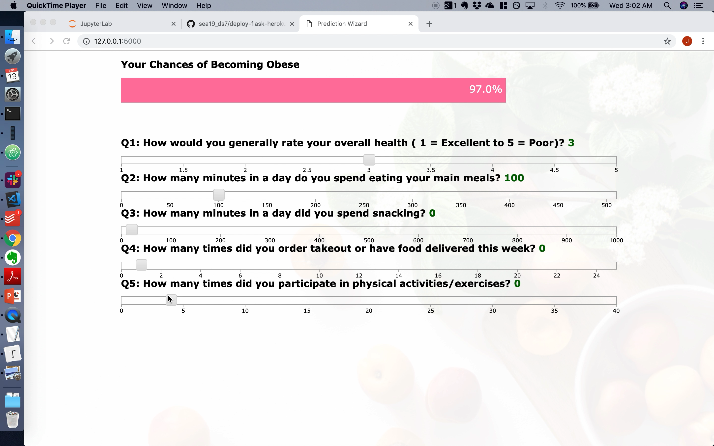




Obesity Prediction Web App
https://obesity-predictor.herokuapp.com/
Question:
What small changes can I make, today?
Hints:
Make adjustments to our weekly habits
+
+
→

Slide 10




Thank You
Data Scientist | Chemist
jhonsen
jhonsen
jhonsen_dj

Slide 11






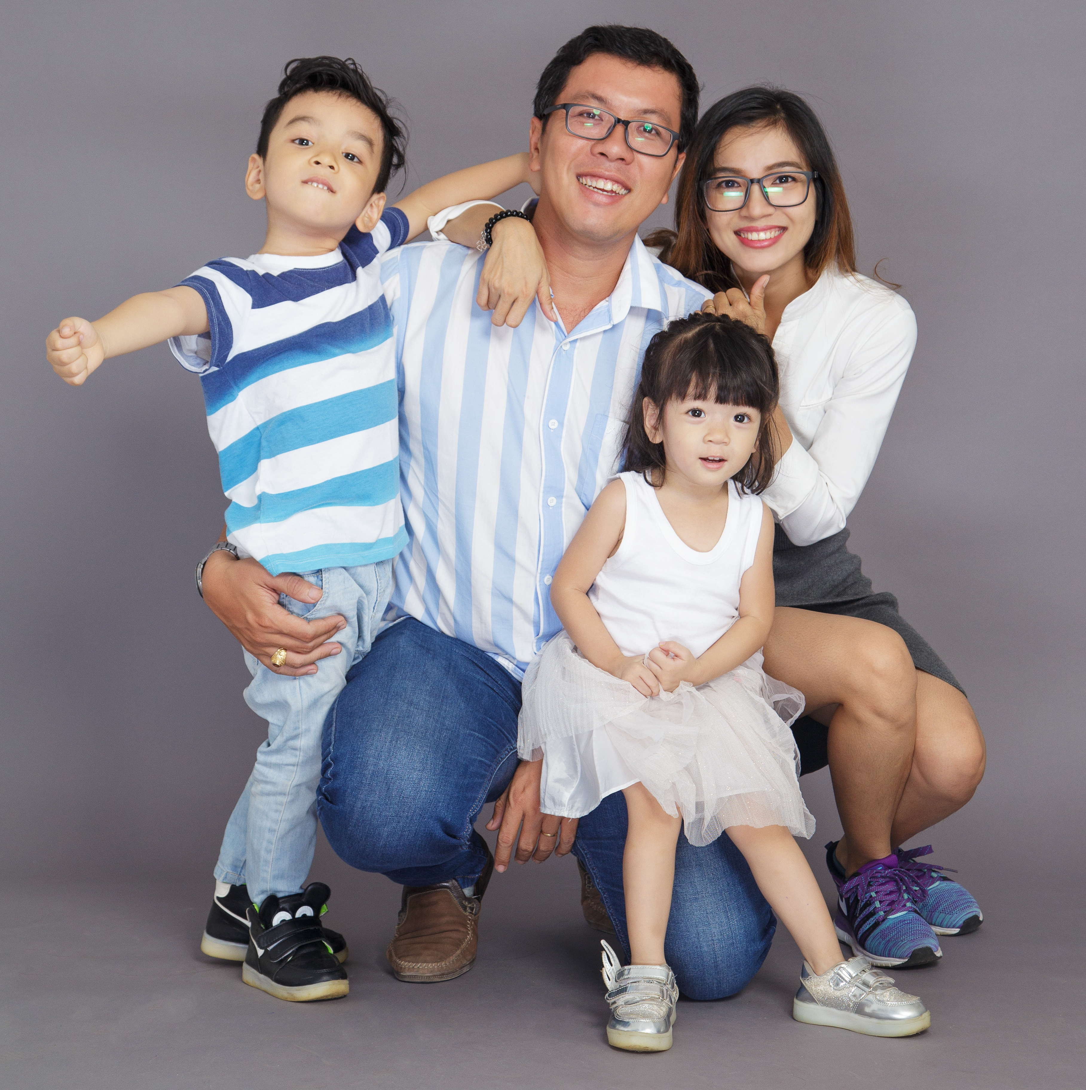


Project Description and Goal
Data Science
for Social Good
Deployment
Photos from https://www.pexels.com/
Notes:
GET GO
Useful for INSTITUTIONAL _ Level
INDIVIDUAL _ Level

Slide 12
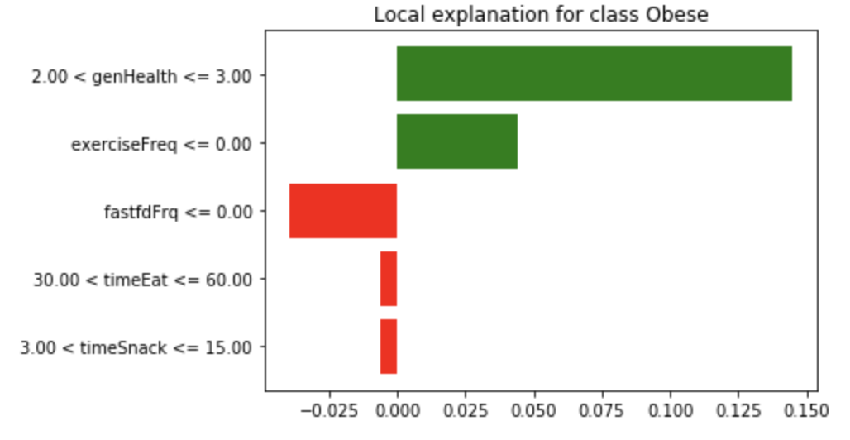
Bringing Interpretability to “Black-Box”
Appendix to slide #7
The impact of each variable on P(Obese)
Not Obese | Obese

Slide 13
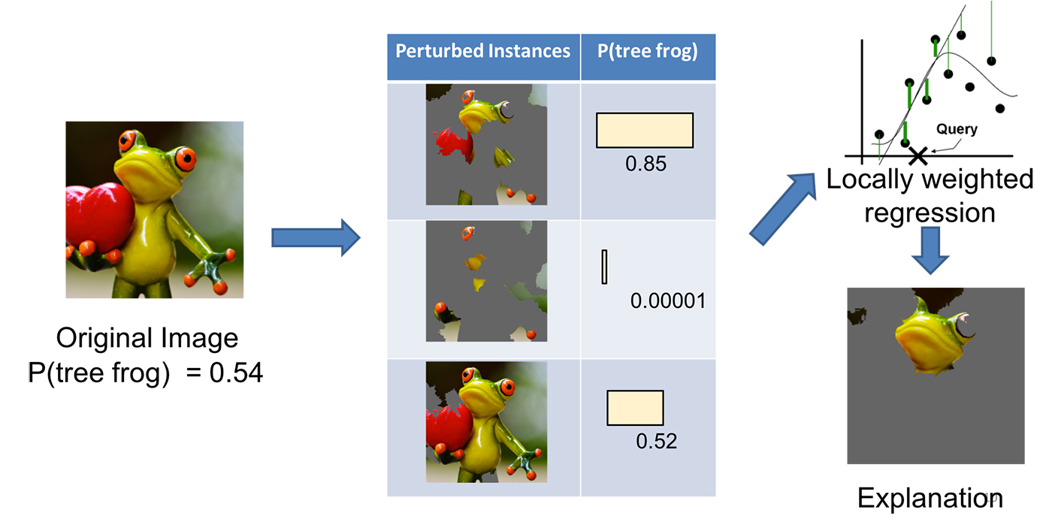
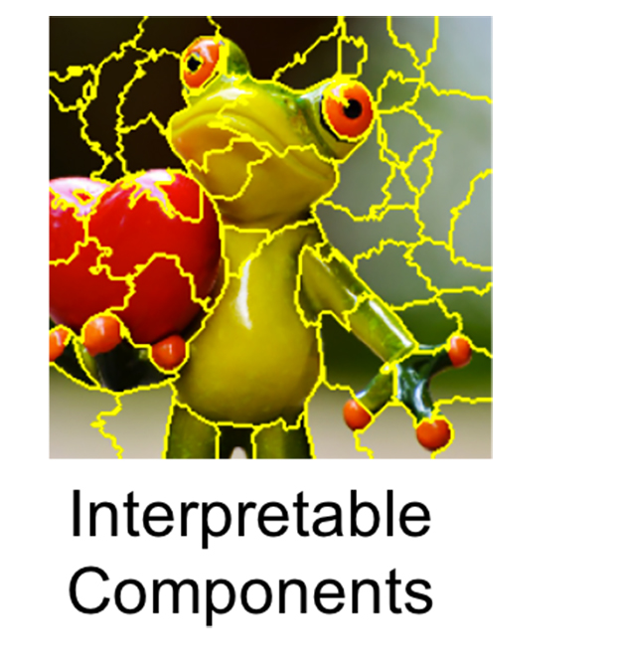
Bringing Interpretability to “Black-Box”
Appendix to slide #7
Quick blurb about LIME
LIME references:
https://github.com/marcotcr/lime
https://arxiv.org/abs/1602.04938
https://www.oreilly.com/learning/introduction-to-local-interpretable-model-agnostic-explanations-lime

Slide 14
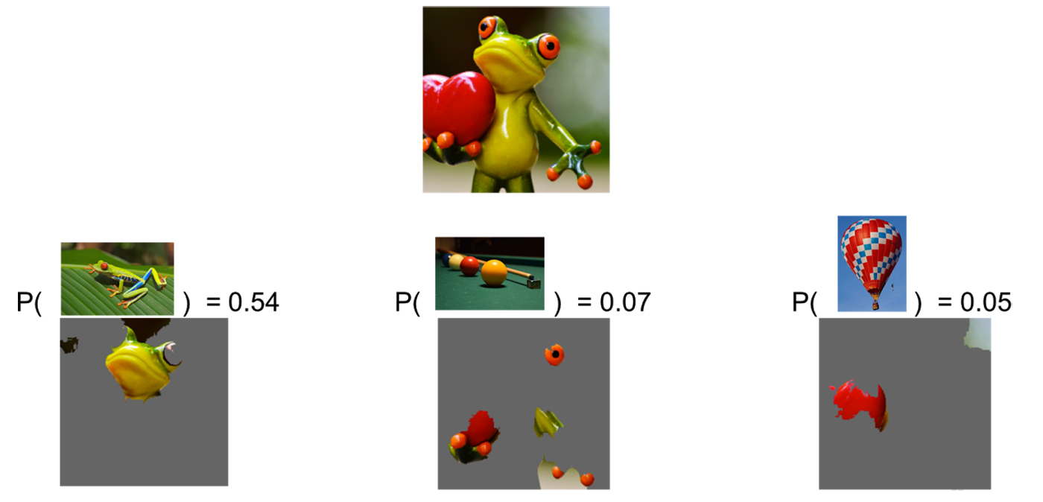
Bringing Interpretability to “Black-Box”
Appendix to slide #7
Quick blurb about LIME
Local segments of tree-frog picture

Slide 15
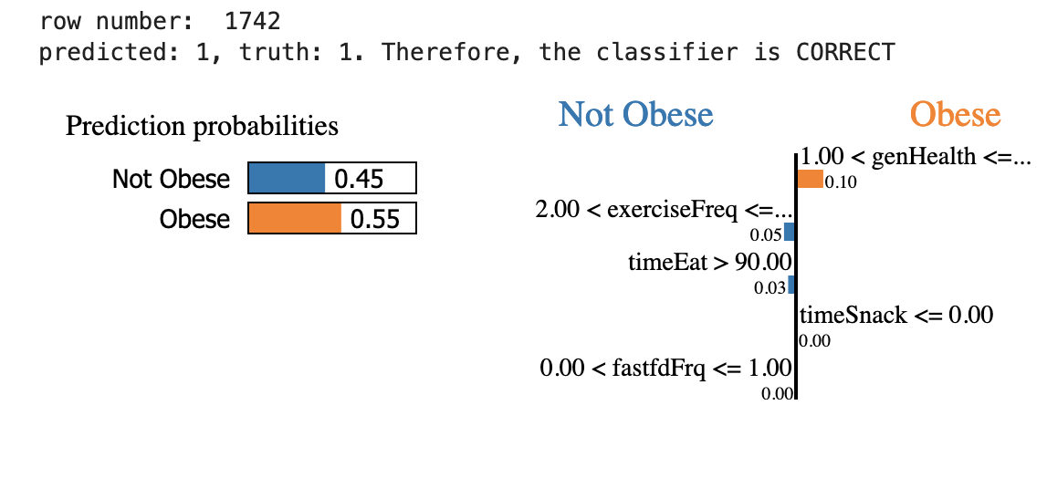
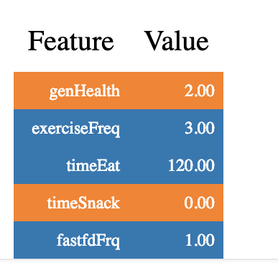
Strange Feature-Target Pair
Appendix to slide #8
(Very Good )
(2 hrs)
Isn’t this person generally healthy?

Slide 16
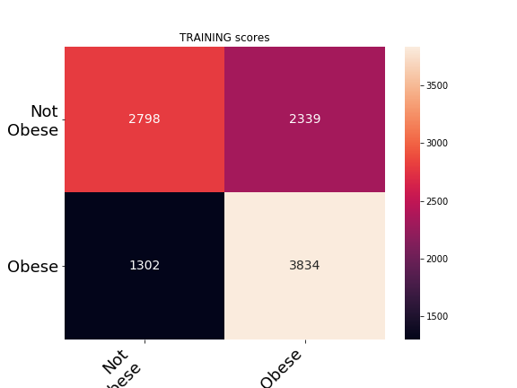
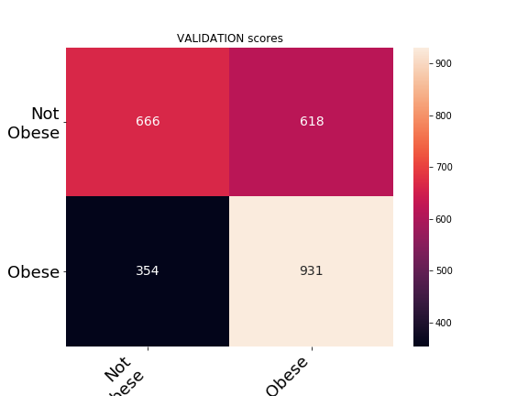
Confusion Matrix for Train-Val Set
Appendix to slide #6
Performance of models based on Training Set

Slide 17
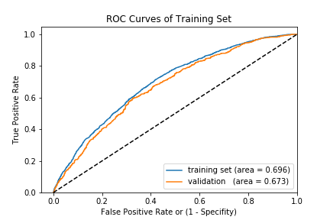
ROC Curve of Training-Val Set
Appendix to slide #6
Performance of models based on Training Set
Random Forest model

